Slide 1

Hub Identification in Global Flight Network
Objective:
Identify critical hubs in the global air network using centrality measures.

Slide 2
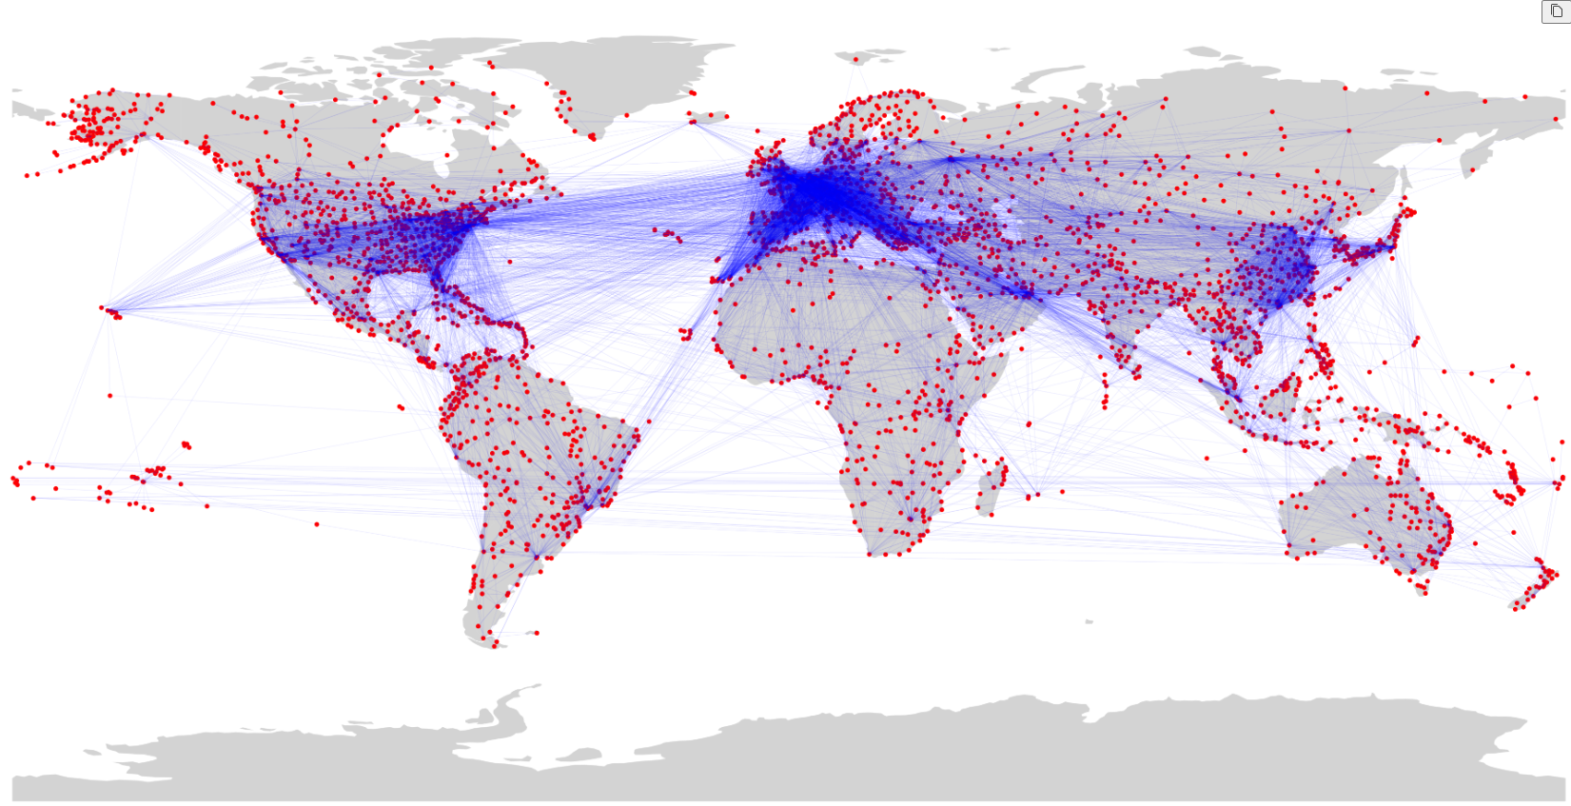

Slide 3
Hub Identification in Global Flight Network
Approach:
Used Random Forest to predict closeness and betweenness centralities.

Slide 4
Hub Identification in Global Flight Network
Key Metrics:
- Closeness Centrality: R² = 0.85, MSE = 0.00034
- Betweenness Centrality: R² = 0.69, MSE = 0.000009
Cross Validation Scores:
- Closeness Centrality: Mean = 0.76
- Betweenness Centrality: Mean = 0.58

Slide 5
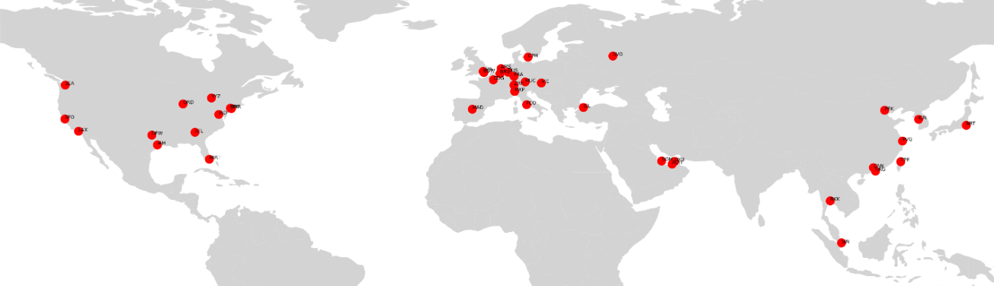
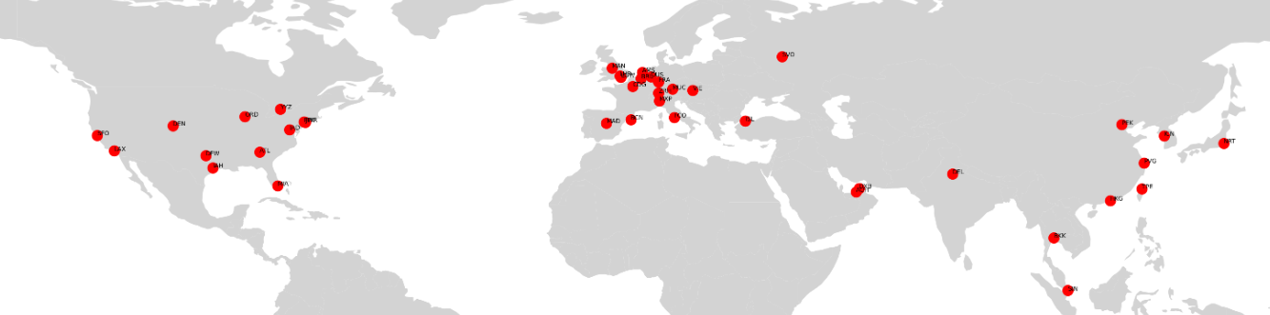
Closeness Predicted
Closeness Real

Slide 6
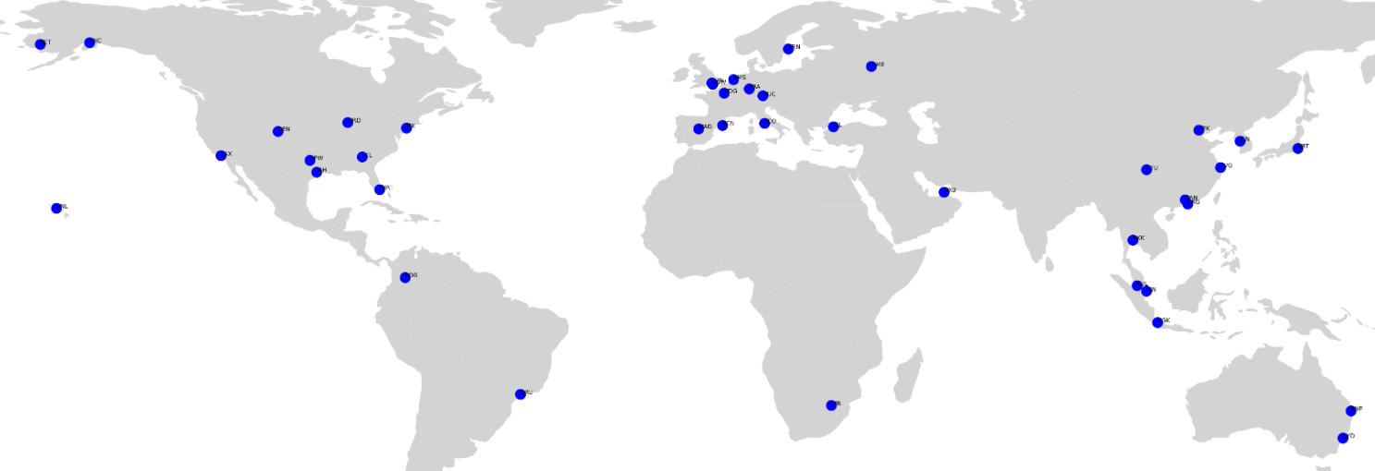
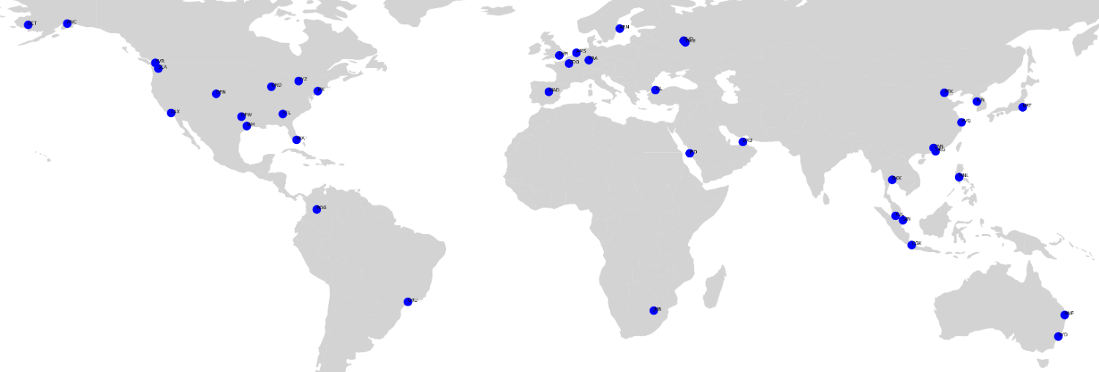
Betweenness Predicted
Betweenness Real

Slide 7
Hub Identification in Global Flight Network
Key Insights:
Closeness and Betweenness centralities effectively predict hubs.

Slide 8
Hub Identification in Global Flight Network
Applications:
Optimize air travel, route planning, and anomaly detection.

